Slide 1
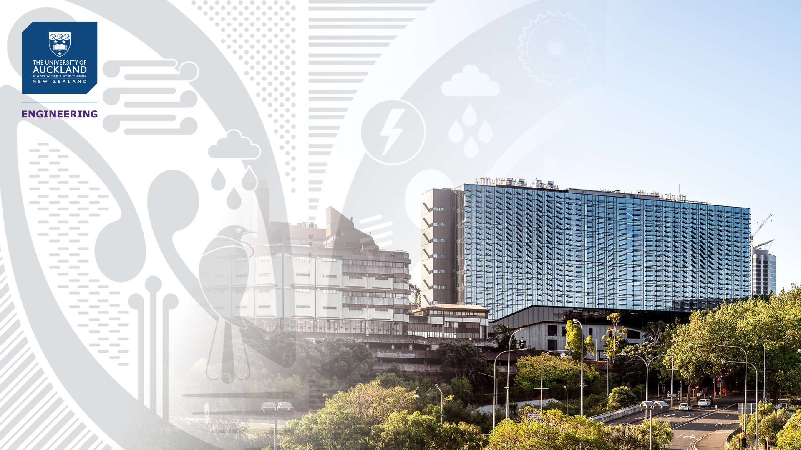
Speech technology development for under-resourced languages
Jesin James
Department of Electrical, Computer, and Software Engineering
Friday, 25 February 2022
International Workshop on Speech Synthesis and Language Technology,
The University of Kerala

Slide 2
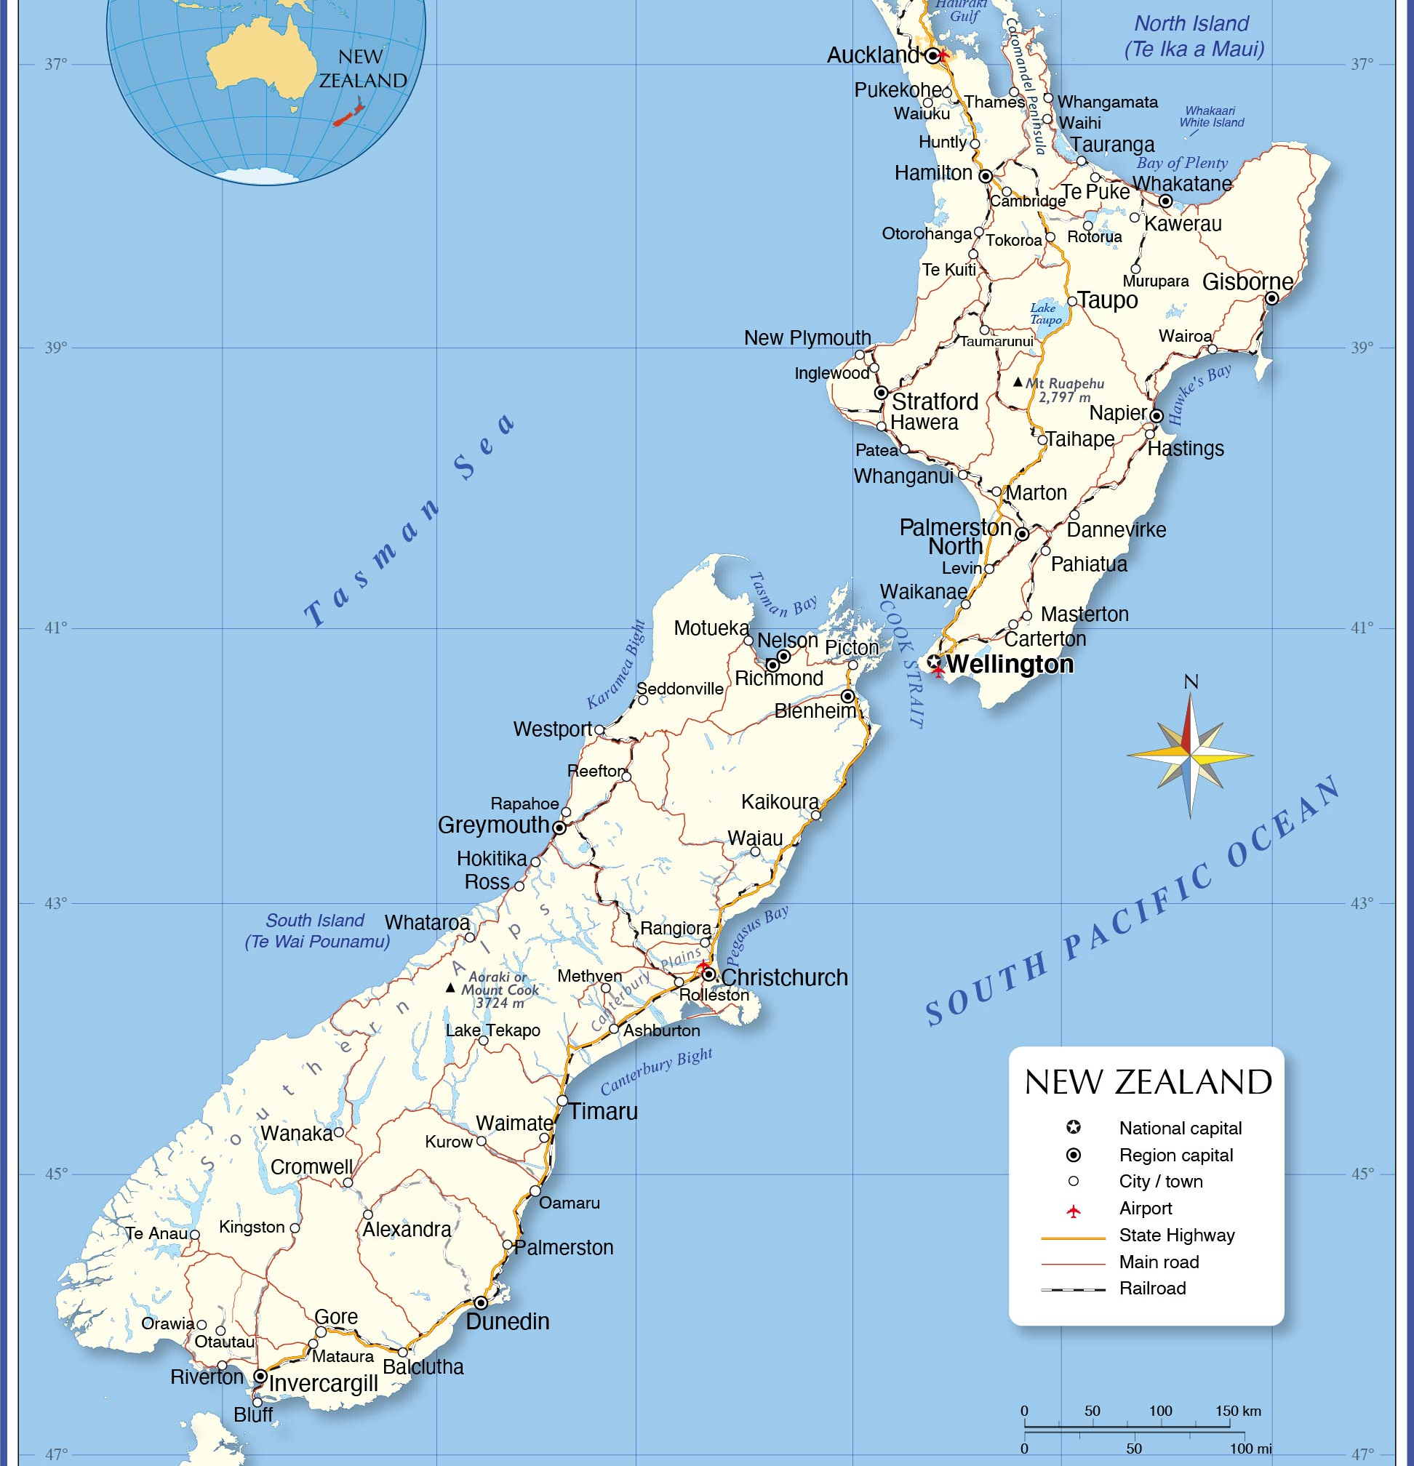
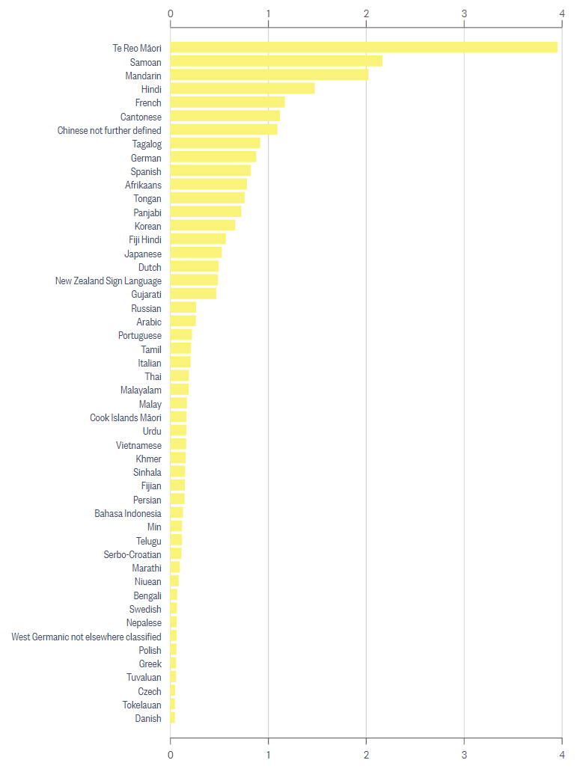
Percentage of people in 2018 census

Slide 3



Part 1 – Basics of Human Speech production
Part 2 – Artificial Speech Production
Part 3 – Speech synthesis in under-resourced languages

Slide 4


Slide 5
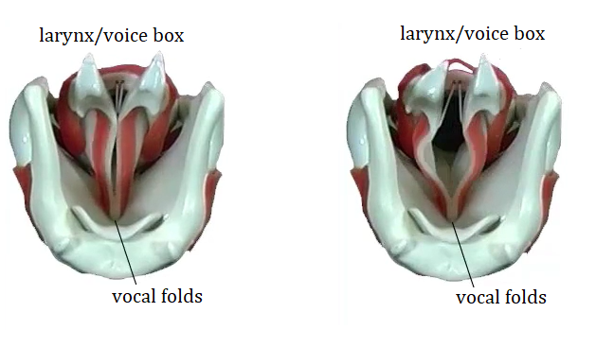
Human speech production
Figure: Vocal folds while breathing
When we exhale high pressure air comes out through the gap in the vocal folds.
*Figures and videos from University of New South Wales School of Physics materials.

Slide 6
Human speech production
Figure: Vocal folds while breathing
When we speak, a portion of this high pressure air is converted into sound.
*Figures and videos from University of New South Wales School of Physics materials.

Slide 7
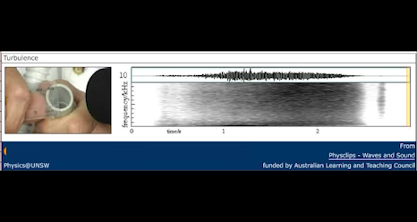
Human speech production
Video: A constriction like vocal folds while breathing (or when air flows through it)
*Figures and videos from University of New South Wales School of Physics materials.
Notes:
Note: only breathing or just air flow causes this sound – just through a tube – rest of parts involved in speech production not coming into play here.

Slide 8
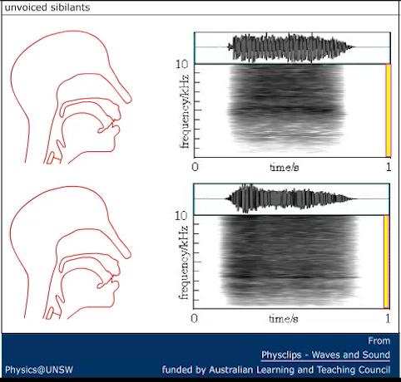
Human speech production
Video: Other constrictions with lips and teeth also producing sounds “s”, “f”.
Such sounds are called unvoiced speech – because the vocal folds are not vibrating here.
*Figures and videos from University of New South Wales School of Physics materials.
Notes:
Note: only breathing or just air flow causes this sound – just through a tube – rest of parts involved in speech production not coming into play here.

Slide 9
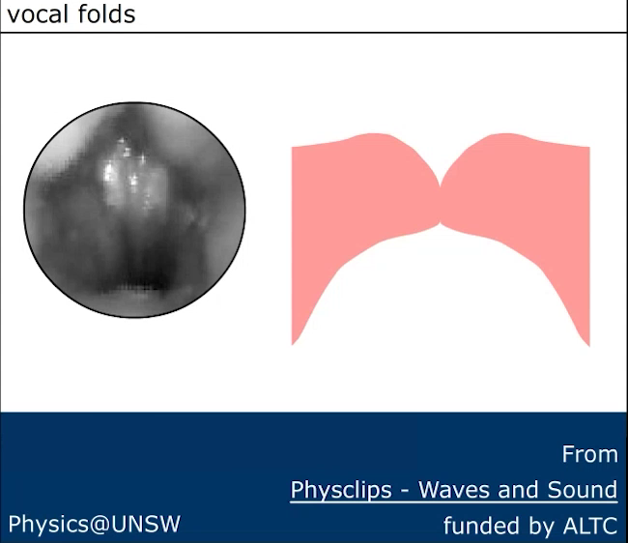
Human speech production
Video: Vocal folds vibrating
We can also make the vocal folds vibrate.
These vibrations can be more than 100 times per second (muscle vibrations)
*Figures and videos from University of New South Wales School of Physics materials.

Slide 10
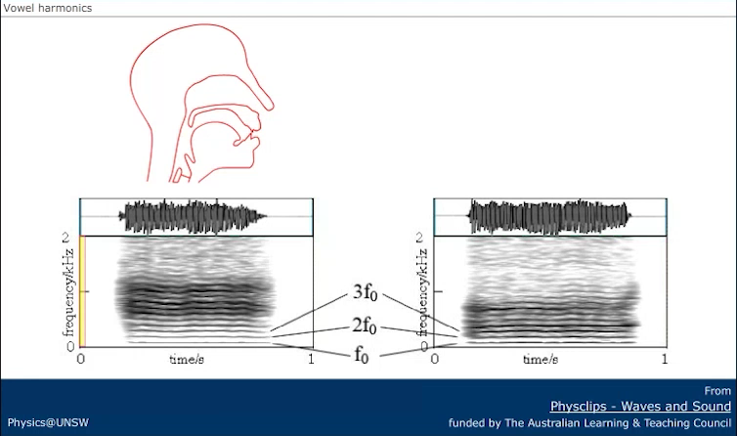
Human speech production
Video: Vocal folds vibrating to produce sounds /a/ and /u/.
The positioning of the mouth, tongue, lips, nasal civility, vocal tract can shape the sound.
This produces different sounds. Such sounds produced by vocal fold vibration are called voiced speech.
*Figures and videos from University of New South Wales School of Physics materials.

Slide 11
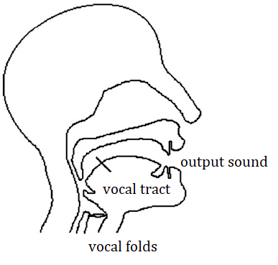
Human speech production
Source
- produces an initial sound
Vocal tract filter
– modifies it
Output speech
A common approach: considers speech production as involving two almost separate processes.
For example, at the larynx/voice box’ -produce a sound which contains many different frequencies.
Then, using tongue, teeth, lips, velum etc, (collectively called articulators) we modify that sound
Figure: Simplified view of human speech production.
*Figures and videos from University of New South Wales School of Physics materials.

Slide 12
Human speech production
Source
- produces an initial sound
Vocal tract filter
– modifies it
Output speech
A common approach: considers speech production as involving two almost separate processes.
Source-Filter Model
Figure: Simplified view of human speech production.
*Figures and videos from University of New South Wales School of Physics materials.

Slide 13
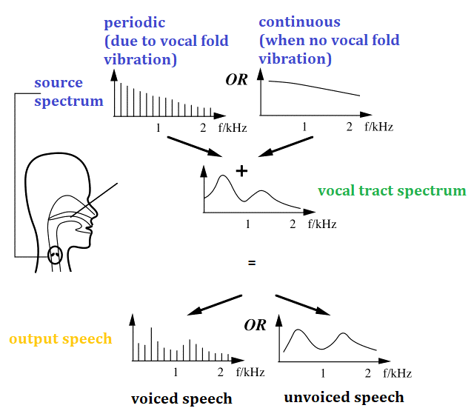
Human speech production
Figure: Simplified speech production spectra (ignoring lip radiation)
*Figures and videos from University of New South Wales School of Physics materials.
Notes:
In the Source-Filter model (Fant 1960), interactions between sound waves in the mouth and the source of sound are neglected. Although oversimplified, this model explains many important characteristics of voice production.
Let’s apply it to two of the sources that we have discussed already. In the spectrum of a whispered voice, the spectrum produced by turbulent flow between the vocal folds produces very many frequencies: it looks like a continuous line. For normal voiced speech, however, the motion of the vocal folds is a periodic vibration that modulates the flow of air, which produces a harmonic spectrum. (More details and graphs are given below.) The cartoon below uses these to illustrate the Source Filter model.

Slide 14


Slide 15





Artificial speech production
Text to speech synthesis
Hello,
how are you?
Hello,
how are you?
Input text
Output speech

Slide 16
Artificial speech production
Two main properties required in synthetic speech – naturalness, intelligibility
Hello,
how are you?
Hello,
how are you?
Input text
Output speech

Slide 17


Speech synthesis technologies
Concatenative synthesis
Concatenative synthesis is based on the concatenation of segments of recorded speech.
Most natural-sounding synthesized speech.

Slide 18
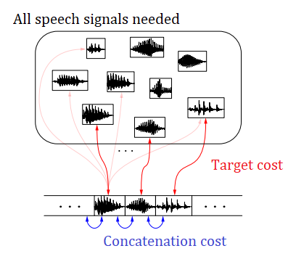
Speech synthesis technologies
Concatenative synthesis
- Speech database
*Image adapted from Statistical parametric speech synthesis: from HMM to LSTM-RNN, 2015, RTTH Summer School on Speech Technology, Spain

Slide 19
Speech synthesis technologies
Source
- produces an initial sound
Vocal tract filter
– modifies it
Output speech
Parametric speech synthesis - Modeling

Slide 20

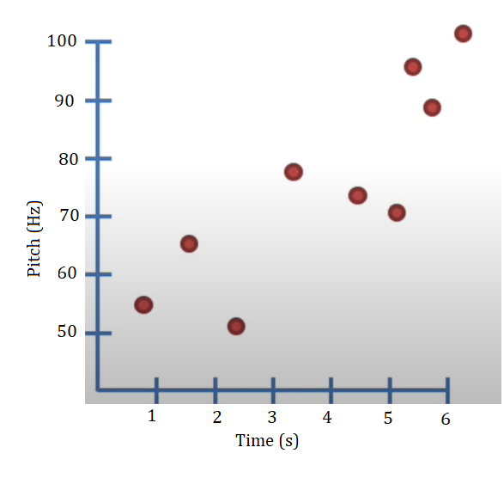
Side note: What is a model?
Obvious relation:
As time increases, pitch increases.
How can I simplify this information?
Mean/Average = 74.11 Hz
Standard deviation = ±24 Hz
Just this information is called a model.
Suppose I have some data points that look like above.
A relationship between the Pitch vs time is called a model.

Slide 21
Side note: What is a feature?
Characteristics or properties of a physical quantity – temperature, volume are all features of different physical quantities.

Slide 22
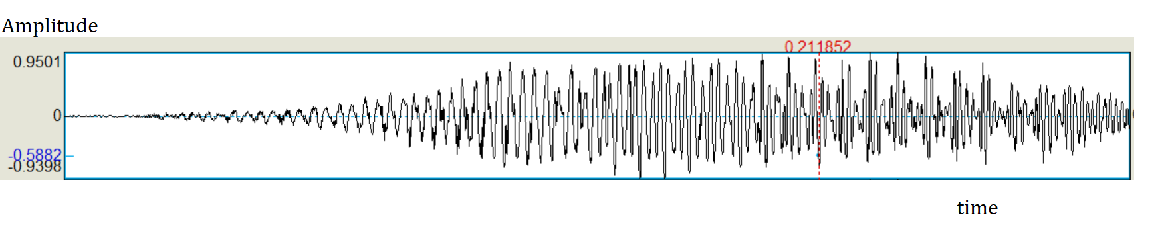
Side note: What is an acoustic feature?
Amplitude
Duration
Time period
Frequency = 1/time period
Characteristics or properties of speech (physical quantity).

Slide 23
Side note: What is a linguistic feature?
My name is Jesin James.
Some linguistic features of the word “Jesin” are:
Part of Speech (Proper Noun)
Forward/backward position of word in phrase (4th from front, 2nd from back)
Number of syllables in current word (2)
Characteristics or properties of word/character/sentence.

Slide 24
Speech synthesis technologies
Source
- produces an initial sound
Vocal tract filter
– modifies it
Output speech
We shall discuss:
General approach
How is linguistics involved?
1. Parametric speech synthesis – using Hidden Markov Models
2. Deep Learning-based speech synthesis

Slide 25
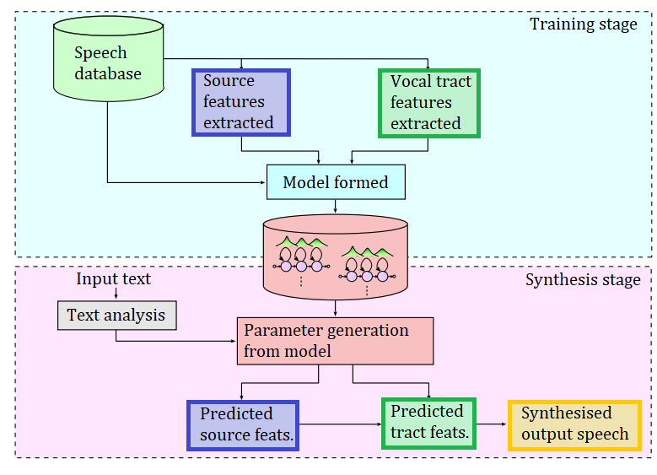
Speech synthesis technologies
Parametric speech synthesis- General approach
Source
- produces an initial sound
Vocal tract filter
– modifies it
Output speech
Text analysis
Hidden Markov Model
Labels
Figure: Source-filter model for human speech production
Hidden Markov Model
This approach maps (models) linguistic features into acoustic features with various decision trees.
Figure: Parametric speech synthesis system

Slide 26

Speech synthesis technologies
Parametric speech synthesis- How is linguistics involved?
Acoustic features
Text analysis
Hidden Markov Model
Linguistic features
Labels
Model
Hidden Markov Model
This approach maps (models) linguistic features into acoustic features with various decision trees.
Figure: Parametric speech synthesis system

Slide 27
Speech synthesis technologies
Parametric speech synthesis- How is linguistics involved?
Speech database contains:
Text
Corresponding recording (wav file)
Should have:
Good sentence selection
Choose text that is not copyrighted or prepare text yourself.
Good coverage of all phones in the language
Text analysis
Hidden Markov Model
Labels
Hidden Markov Model
Figure: Parametric speech synthesis system

Slide 28
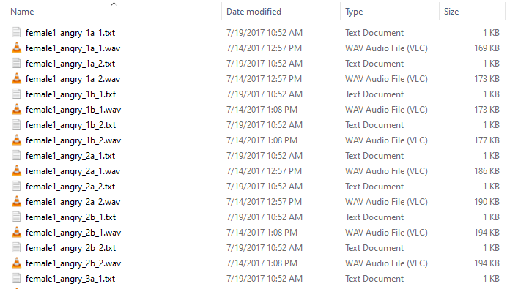
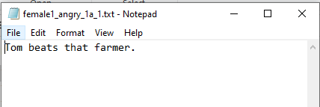
Speech synthesis technologies
Parametric speech synthesis- How is linguistics involved?
Speech database contains:
Text
Corresponding recording (wav file)
Should have:
Good sentence selection
Choose text that is not copyrighted or prepare text yourself.
Good coverage of all phones in the language
*Wav and text files from JLCorpus:
James, J., Tian, L. and Watson, C.I., 2018, September. An Open Source Emotional Speech Corpus for Human Robot Interaction Applications. In Interspeech (pp. 2768-2772).

Slide 29
Speech synthesis technologies
Parametric speech synthesis- How is linguistics involved?
Speech database contains:
Text
Corresponding recording (wav file)
Should have:
Good sentence selection
Choose text that is not copyrighted or prepare text yourself.
Good coverage of all phones in the language
Text analysis
Hidden Markov Model
Labels
Hidden Markov Model
Figure: Parametric speech synthesis system

Slide 30
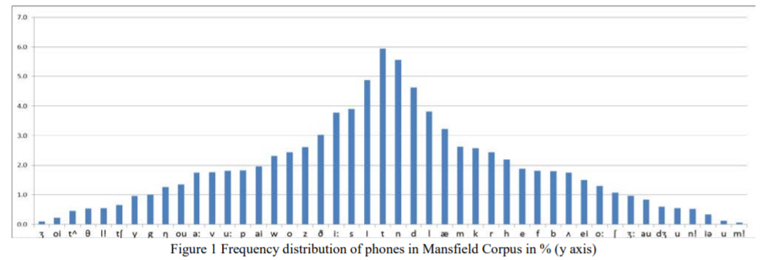
Speech synthesis technologies
Parametric speech synthesis- How is linguistics involved?
Speech database contains:
Text
Corresponding recording (wav file)
Should have:
Good sentence selection
Choose text that is not copyrighted or prepare text yourself.
Good coverage of all phones in the language
Frequency distribution of phones for the Mansfield Corpus (% y axis) in New Zealand English. Image from *.
*Watson, C.I. and Marchi, A., 2014. Resources created for building New Zealand english voices. In Proc. 15th Australas. Int. Conf. Speech Science and Technology (pp. 92-95).

Slide 31
Speech synthesis technologies
Parametric speech synthesis- How is linguistics involved?
Text/Linguistic analysis includes:
Extracting linguistic features from the text in the database.
This requires:
Preprocessing or text normalisation
A pronunciation dictionary
Grapheme to phoneme conversion
Linguistic feature extraction
Text analysis
Hidden Markov Model
Labels
Hidden Markov Model
Figure: Parametric speech synthesis system

Slide 32
Speech synthesis technologies
Parametric speech synthesis- How is linguistics involved?
Text/Linguistic analysis includes:
Extracting linguistic features from the text in the database.
This requires:
Preprocessing or text normalisation
A pronunciation dictionary
Grapheme to phoneme conversion
Linguistic feature extraction
Example: Abbreviation expansion, numeral expansion
Example sentence:
I will meet Sam at 9 pm near Symonds st.
After text normalization:
I will meet Sam at nine pm near Symonds street.

Slide 33
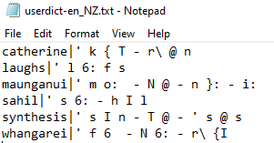
Speech synthesis technologies
Parametric speech synthesis- How is linguistics involved?
Text/Linguistic analysis includes:
Extracting linguistic features from the text in the database.
This requires:
Preprocessing or text normalisation
A pronunciation dictionary
Grapheme to phoneme conversion
Linguistic feature extraction
Figure: Pronunciation dictionary for New Zealand English using SAMPA phonetic symbols.

Slide 34
Speech synthesis technologies
Parametric speech synthesis- How is linguistics involved?
Text/Linguistic analysis includes:
Extracting linguistic features from the text in the database.
This requires:
Preprocessing or text normalisation
A pronunciation dictionary
Grapheme to phoneme conversion
Linguistic feature extraction
Grapheme-to-phoneme (G2P) conversion is a task of converting letters (grapheme sequence) to their pronunciations (phoneme sequence).
For example:
I will meet Sam at nine pm near Symonds street.
After G2P – using SAMPA symbols:
aI w I l m i: t s { m { t n aI n p m n I@ s I m @ n d z s t r i: t

Slide 35
Speech synthesis technologies
Parametric speech synthesis- How is linguistics involved?
Text/Linguistic analysis includes:
Extracting linguistic features from the text in the database.
This requires:
Preprocessing or text normalisation
A pronunciation dictionary
Grapheme to phoneme conversion
Linguistic feature extraction
For every phone, a set of linguistic features (like 150-300 features) are extracted:
For example:
aI w I l m i: t s { m { t n aI n p m n I@ s I m @ n d z s t r i: t
Consider I alone:
Phone: I
No. of words from beginning: 2
No. of words from end: 9
Total number of words: 10
No. of phones from beginning: 2
No. of phones from end: 29
etc.
So, linguistic feature array of I will look like: [I, 2, 9, 10, 2, 29]

Slide 36
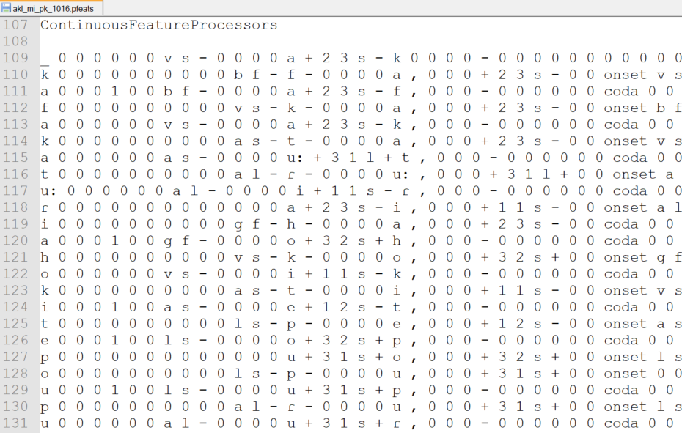
Speech synthesis technologies
Parametric speech synthesis- How is linguistics involved?
Text/Linguistic analysis includes:
Extracting linguistic features from the text in the database.
This requires:
Preprocessing or text normalisation
A pronunciation dictionary
Grapheme to phoneme conversion
Linguistic feature extraction
What is obtained after this step looks like this:

Slide 37
Speech synthesis technologies
Parametric speech synthesis- How is linguistics involved?
Text/Linguistic analysis includes:
Extracting linguistic features from the text in the database.
This requires:
Preprocessing or text normalisation
A pronunciation dictionary
Grapheme to phoneme conversion
Linguistic feature extraction
Labelling
This is to connect the text and the recording:

Slide 38
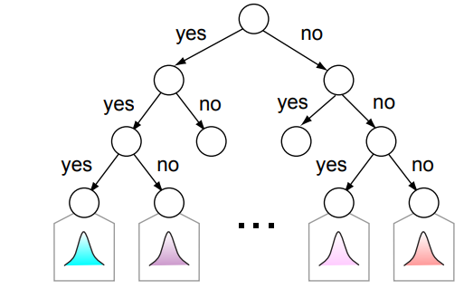
Speech synthesis technologies
Parametric speech synthesis- How is linguistics involved?
If the phone is “I”
Based on linguistic features
No. of phones > 20
No. of phones > 10 and < 5
Text analysis
Hidden Markov Model
Labels
No. of words = 16
No. of words = 6
Generating acoustic features
Hidden Markov Model
Acoustic features model:
Average pitch = 150 Hz
Average intensity = 40 dB
Speech rate = 3 syllables/s
Acoustic features model:
Average pitch = 100 Hz
Average intensity = 70 dB
Speech rate = 4 syllables/s
Acoustic features model:
Average pitch = 100 Hz
Average intensity = 50 dB
Speech rate = 2 syllables/s
Acoustic features model:
Average pitch = 200 Hz
Average intensity = 60 dB
Speech rate = 2 syllables/s
Figure: Parametric speech synthesis system

Slide 39
Speech synthesis technologies
Parametric speech synthesis- How is linguistics involved?
For a TTS: Input is text ONLY.
For eg: “Welcome to the world of speech synthesis.”
Same steps as before are needed:
Text normalization.
Grapheme to phoneme
w e l k @ m t @ D @ w 3: l d @ v s p i: t S s I n T i: s I s
Linguistic features extracted.
E.g. for phone “D” – [D 1 0 11 12 ….]
Text analysis
Hidden Markov Model
Labels
Hidden Markov Model
Figure: Parametric speech synthesis system

Slide 40
Speech synthesis technologies
Parametric speech synthesis- How is linguistics involved?
E.g. for phone “D” – [D 1 0 11 12 ….]
We trace back from the model:
If the phone is “D”
Based on linguistic features
No. of phones > 20
No. of phones > 10 and < 5
Text analysis
Hidden Markov Model
Labels
No. of words = 16
No. of words = 6
Generating acoustic features
Hidden Markov Model
Acoustic features model:
Average pitch = 150 Hz
Average intensity = 40 dB
Speech rate = 3 syllables/s
Acoustic features model:
Average pitch = 100 Hz
Average intensity = 70 dB
Speech rate = 4 syllables/s
Acoustic features model:
Average pitch = 100 Hz
Average intensity = 50 dB
Speech rate = 2 syllables/s
Acoustic features model:
Average pitch = 200 Hz
Average intensity = 60 dB
Speech rate = 2 syllables/s
Figure: Parametric speech synthesis system

Slide 41
Speech synthesis technologies
Parametric speech synthesis
This approach maps linguistic features into probability densities of speech parameters with various decision trees.
Text analysis
Hidden Markov Model
Labels
Hidden Markov Model
Figure: Parametric speech synthesis system

Slide 42
Speech synthesis technologies
Deep Learning based synthesis
Neural Network (NN) : A series of algorithms that endeavors to recognize underlying relationships in a set of data through a process that mimics the way the human brain operates.
Traditional speech synthesis systems: Each component is trained independently and rely on extensive domain expertise which are laborious, errors from each component may compound.
End-to-End Speech Synthesis: Combine all components into a unified framework

Slide 43
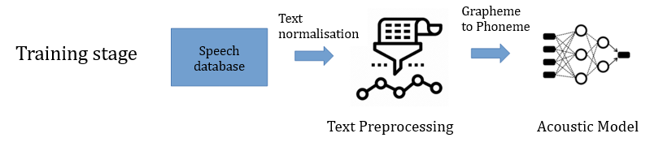
Speech synthesis technologies
Deep Learning based synthesis - General Approach
Trained via neural networks

Slide 44
Speech synthesis technologies
Deep Learning based synthesis -How is linguistics involved?

Slide 45
Speech synthesis technologies
Deep Learning based synthesis – General approach
Speech database contains:
Text
Corresponding recording (wav file)
Should have:
Good sentence selection
Choose text that is not copyrighted or prepare text yourself.
Good coverage of all phones in the language

Slide 46
Speech synthesis technologies
Deep Learning based synthesis – General approach
Example: Abbreviation expansion, numeral expansion
Example sentence:
I will meet Sam at 9 pm near Symonds st.
After text normalization:
I will meet Sam at nine pm near Symonds street.

Slide 47
Speech synthesis technologies
Deep Learning based synthesis – General approach
Grapheme-to-phoneme (G2P) conversion is a task of converting letters (grapheme sequence) to their pronunciations (phoneme sequence).
For example:
I will meet Sam at nine pm near Symonds street.
After G2P – using SAMPA symbols:
aI w I l m i: t s { m { t n aI n p m n I@ s I m @ n d z s t r i: t

Slide 48
Speech synthesis technologies
Deep Learning based synthesis -How is linguistics involved?

Slide 49
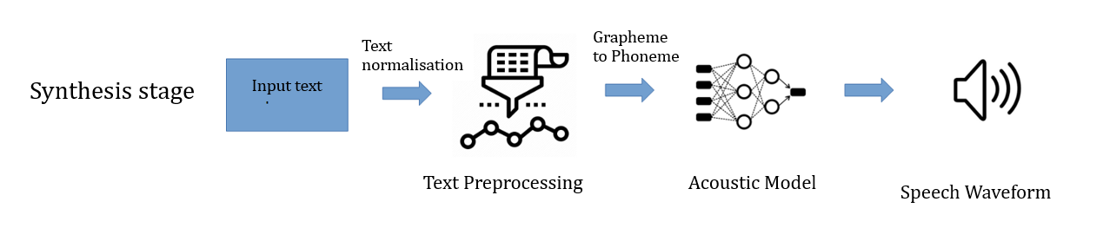
Speech synthesis technologies
Deep Learning based synthesis -How is linguistics involved?
“Welcome to the world of speech synthesis.”
w e l k @ m t @ D @ w 3: l d @ v s p i: t S s I n T i: s I s

Slide 50
Speech synthesis technologies
Deep Learning based synthesis
Deep neural networks are heavily data reliant.
More the speech data available, the better the model.
Wavenet, Tacotron, FastSpeech are examples.

Slide 51
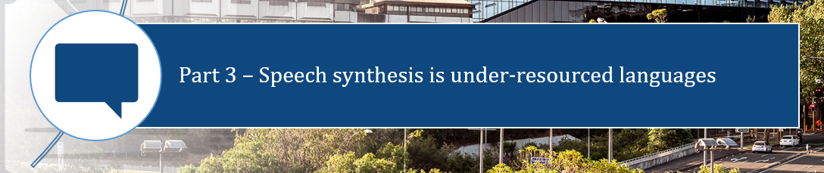

Slide 52

Synthesised speech and languages
வணக்கம்
नमस्कार
hello
നമസ്കാരം

Slide 53
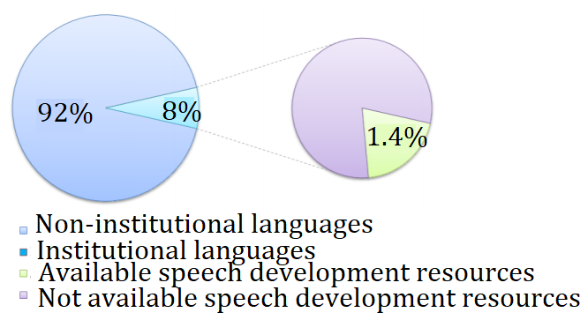
Synthesised speech and languages
வணக்கம்
नमस्कार
Speech technology development is concentrated on only a few languages.
Examples: US English, UK English, Mandarin Chinese, Hindi
hello
A large majority of TTS developments are happening in < 100 languages
നമസ്കാരം
Other languages – called under-resourced languages

Slide 54
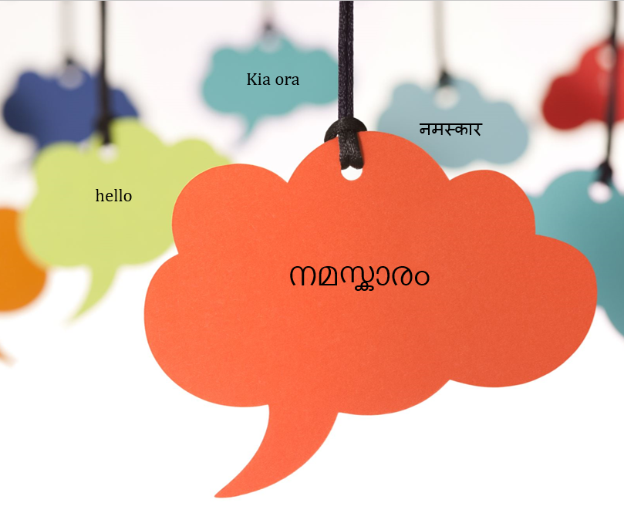
Need for research in speech technology
Real beneficiaries of the human computer interaction - vocally or visually challenged.
Cultural and linguistic backgrounds are dominating factors in acceptance of speech technology.
For people with disabilities, learning a new language to use a TTS will be burdensome.
High quality TTS systems in every language is a requirement.
Notes:
The TTS systems can be used by them for book, newspaper reading and even for disabled children as an aid in studies.

Slide 55
Synthesised speech and languages
Kia ora
नमस्कार
hello
Developed resources for Malayalam.
Developed speech technology for New Zealand English.
Developed resources for te reo Māori.
നമസ്കാരം

Slide 56
Challenges faced and role of linguistics
Text analysis
Parametric speech synthesis
Labels
Item | Requirement
Speech database | At least 1000 sentences – 1 hour Native speaker Studio recording Good phonetic coverage
Phonetic dictionary | List of all words in a language Their phonetic transcription – time consuming and expert task Specific formats required
Labels | Automatic tools exist only for well-resourced languages Time consuming task if done manually
Text pre-processing | Automatic tools exist only for well-resourced languages
Text analysis | Automatic tools exist only for well-resourced languages Language-specific features exist
Notes:
The TTS systems can be used by them for book, newspaper reading and even for disabled children as an aid in studies.

Slide 57
Challenges faced and role of linguistics
Text analysis
Parametric speech synthesis
Labels
Where can linguists support?
Item | Requirement
Speech database | At least 1000 sentences – 1 hour Native speaker Studio recording Good phonetic coverage
Phonetic dictionary | List of all words in a language Phonetic transcription – time consuming and expert task Specific formats required
Labels | Automatic tools exist only for well-resourced languages Time consuming task if done manually
Text pre-processing | Automatic tools exist only for well-resourced languages
Text analysis | Automatic tools exist only for well-resourced languages Language-specific features exist
Notes:
The TTS systems can be used by them for book, newspaper reading and even for disabled children as an aid in studies.

Slide 58
Challenges faced and role of linguistics
Deep Learning based speech synthesis
Item | Requirement
Speech database | 13000 – 15000 sentences – 24 hours Native speaker Studio recording Good phonetic coverage
Text pre-processing | Automatic tools exist only for well-resourced languages
Text analysis | Automatic tools exist only for well-resourced languages Language-specific features exist
Grapheme to phoneme conversion | Automatic tools exist only for well-resourced languages
Notes:
The TTS systems can be used by them for book, newspaper reading and even for disabled children as an aid in studies.

Slide 59
Challenges faced and role of linguistics
Deep Learning based speech synthesis
Where can linguists support?
Item | Requirement
Speech database | 13000 – 15000 sentences – 24 hours Native speaker Studio recording Good phonetic coverage
Text pre-processing | Automatic tools exist only for well-resourced languages
Text analysis | Automatic tools exist only for well-resourced languages Language-specific features exist
Grapheme to phoneme conversion | Automatic tools exist only for well-resourced languages
Notes:
The TTS systems can be used by them for book, newspaper reading and even for disabled children as an aid in studies.

Slide 60
Challenges faced and role of linguistics
Deep Learning based speech synthesis
Where can linguists support?
Item | Requirement
Speech database | 13000 – 15000 sentences – 24 hours Native speaker Studio recording Good phonetic coverage
Text pre-processing | Automatic tools exist only for well-resourced languages
Text analysis | Automatic tools exist only for well-resourced languages Language-specific features exist
Grapheme to phoneme conversion | Automatic tools exist only for well-resourced languages
Very extensive requirement – so adaptation is done for “similar” languages/accents/variants.
Notes:
The TTS systems can be used by them for book, newspaper reading and even for disabled children as an aid in studies.

Slide 61
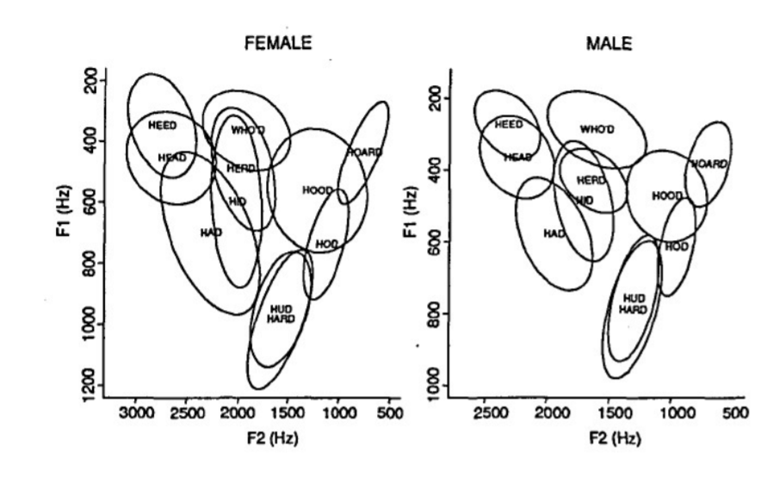
Challenges faced and role of linguistics
Evaluation of synthetic speech
How can we evaluate synthetic speech?
We need expert ears to pick up the pronunciation errors.
Recently, we have been experimenting on using vowel plots.
A vowel plot is a schematic arrangement of the vowels.
Vowel space for New Zealand English*
Image from, Brooke Ross, An Acoustic Analysis of New Zealand English Vowels in Auckland, Masters Thesis, Victoria University of Wellington, 2018
Notes:
The TTS systems can be used by them for book, newspaper reading and even for disabled children as an aid in studies.

Slide 62
Evaluation of synthetic speech
How can we evaluate synthetic speech?
We need expert ears to pick up the pronunciation errors.
Recently, we have been experimenting on using vowel plots.
Vowel plot of “real” New Zealand English speech
Vowel plot of “synthesised” New Zealand English speech
Notes:
The TTS systems can be used by them for book, newspaper reading and even for disabled children as an aid in studies.

